Slide 1
The Virtual Tour with Shannon Egan, Director of the Schmucker Art Gallery. will begin momentarily

Slide 2
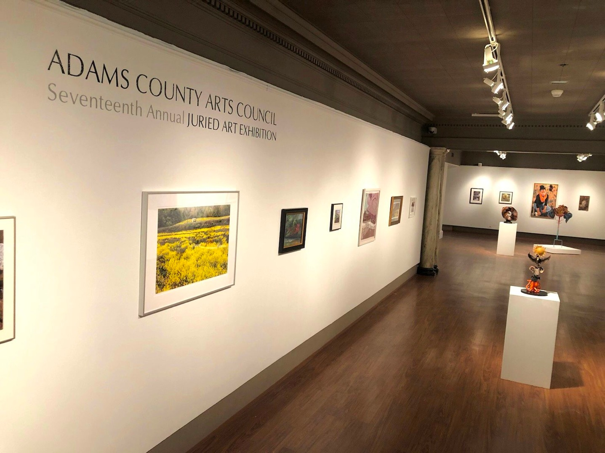

Slide 3
Linda Agar-Hendrix, Ijamsville, MD
Patterns, 2019
photograph, $275

Slide 4
David Allison, Fayetteville, PA Pennsylvania Project- Par Deux #30, 2017, archival pigment print, $1800

Slide 5
John Armstrong,
Gettysburg, PA Hockey Rink Combo, 2018
Photograph, $200

Slide 6
Richard Barvainis, Gettysburg, PA Beach at Findhorn, Scotland, 2019
Photograph, $275

Slide 7
Richard Barvainis, Gettysburg, PA Kauai Landscape, 2019 photograph, $275

Slide 8
Alexander Bellotti, Harrisburg, PA Solitude, 2019, oil on canvas, NFS

Slide 9
Marie Betlyon-Smith, Hanover, PA
Luminous Creatures, 2019, acrylic, $400

Slide 10
Melinda Bitzel, Hampstead, MD
Lily Pads, 2019, oil, acrylic, cardboard, $1500

Slide 11
Melinda Bitzel, Hampstead, MD Melting, 2018, oil, acrylic, cardboard, $800

Slide 12
Matthew Borgen, Philadelphia, PA Horizons, 2019, archival inkjet print, $1500

Slide 13
William Brozy, Fairfield, PA Melancholy under a Harvest Moon, 2019, archival inkjet print, $350

Slide 14
Carolyn Chase, Fayetteville, PA Purple Haze, 2018, glass, $100

Slide 15
Gabe Clarke, Gettysburg, PA 2.19, 2018, spray paint, hollow-core door, $865

Slide 16
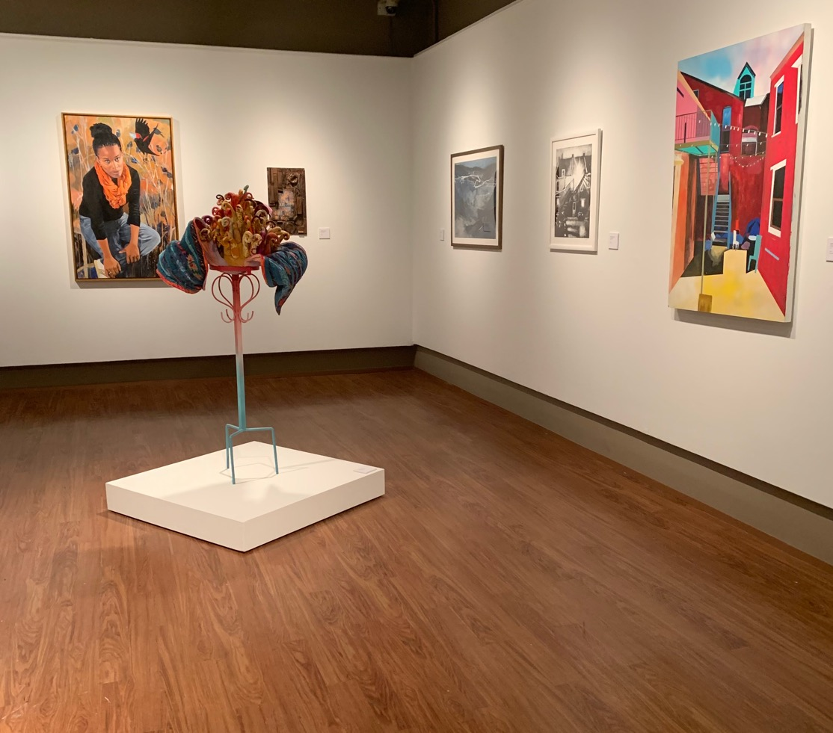

Slide 17
Sandra Desrosiers, Hanover, PA Turkish Treasure, 2020, oil on canvas, NFS

Slide 18
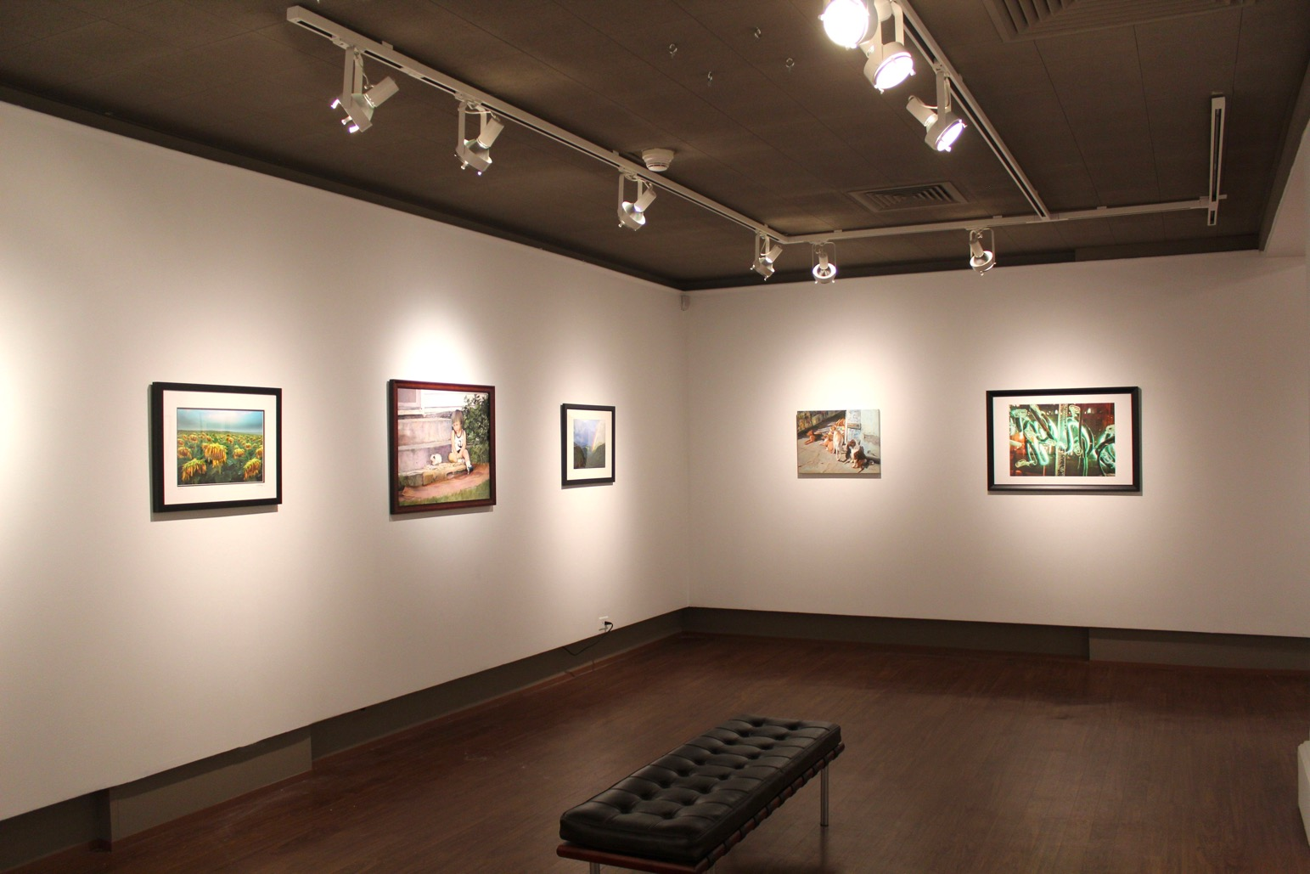

Slide 19
Barbara DeUgarte, Gettysburg, PA Havana Hounds, 2019
oil on canvas, $850

Slide 20
Andrea Finch, Chambersburg, PA
Magnolia Grandiflora VI: The Flower, 2018, fiber, $589

Slide 21
Anne Finucane, Chambersburg, PA Early Spring View, 2020, linocut, hand-colored with watercolor, $85

Slide 22
Katherine Fraser, Philadelphia, PA Past Life, 2017, oil on canvas, $5600

Slide 23
Linda Gottfried, Fayetteville, PA
And Ye Shall Have Dominion,
2019, ceramic, $475

Slide 24
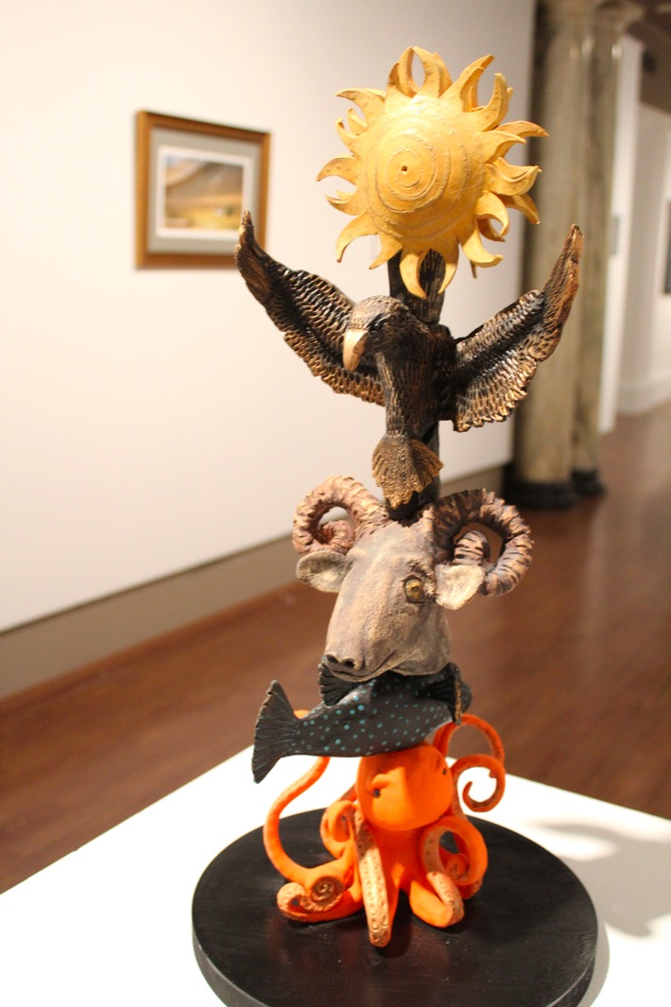

Slide 25
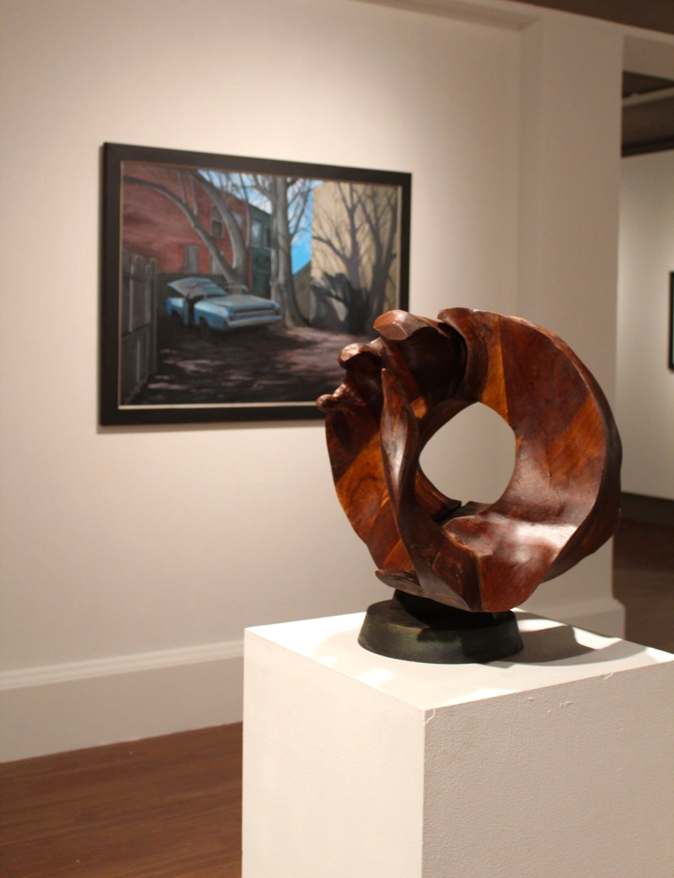

Slide 26
Geoff Grant, Fairfield, PA
Lone Cottage, 2019, digital photograph, $195

Slide 27
Mary Grassell, Fayetteville, PA
In the Protection of the Duomo,
2018, watercolor, wax, ink, $650

Slide 28
Jack Handshaw, Fairfield, PA Harvest, 2019, raku pottery, $250

Slide 29
Michael Hower, Enola, PA
The Muckers, 2019, digital photograph, $225

Slide 30
Patricia Hutchinson, Belmar, NJ Emmy, 2017, mixed media, $5000

Slide 31
Roberta Iula, Newville, PA
Big Trees, 2020,
acrylic on canvas, $1500

Slide 32
Brooke Jana, Waverly, PA Broken Peace Pipeline, 2019, giclée print, $800

Slide 33
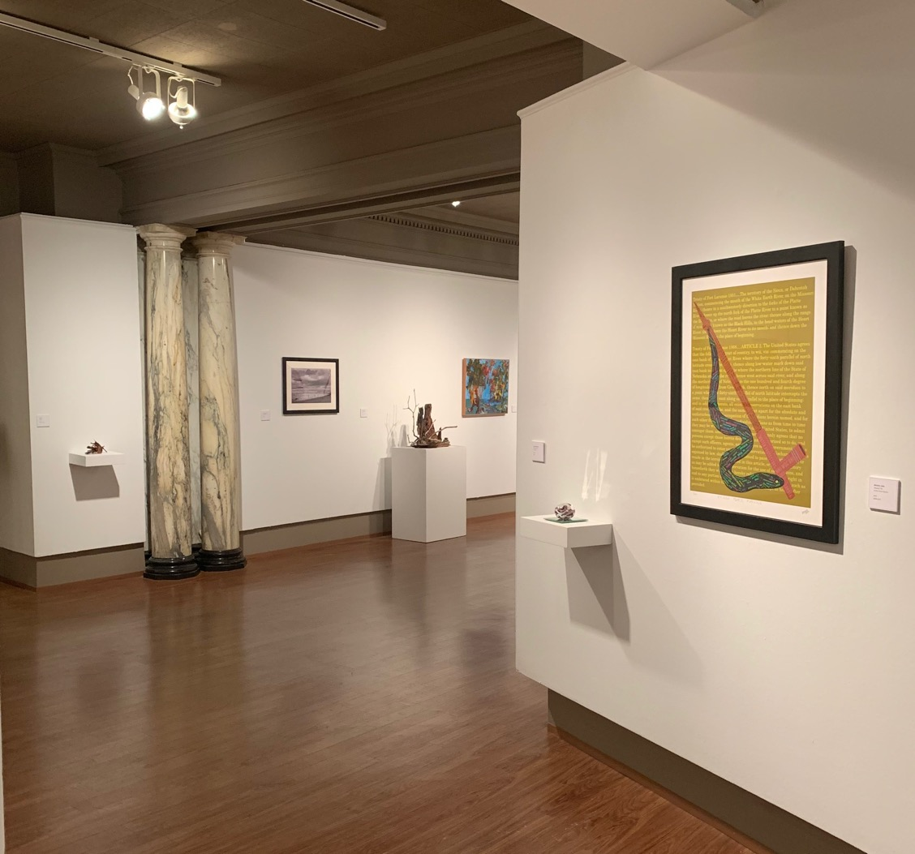

Slide 34
Barbara Johnson, McEwensville, PA Tin Can Alley, 2020, collage, $300

Slide 35
Christopher Lauer, Gettysburg, PA Untitled #2, 2019, monotype, $750

Slide 36
Jin Lee, Riva, MD
In Check, 2019, copper, steel, wood, $400

Slide 37
Dan Mangan, Fairfield, PA Fashionistas, Battistero di San Giovanni,
Florence, 2018, photograph on metal, $500

Slide 38
Martha Martin, Gettysburg, PA Nestled in Stone, 2019, Picasso marble. $800

Slide 39
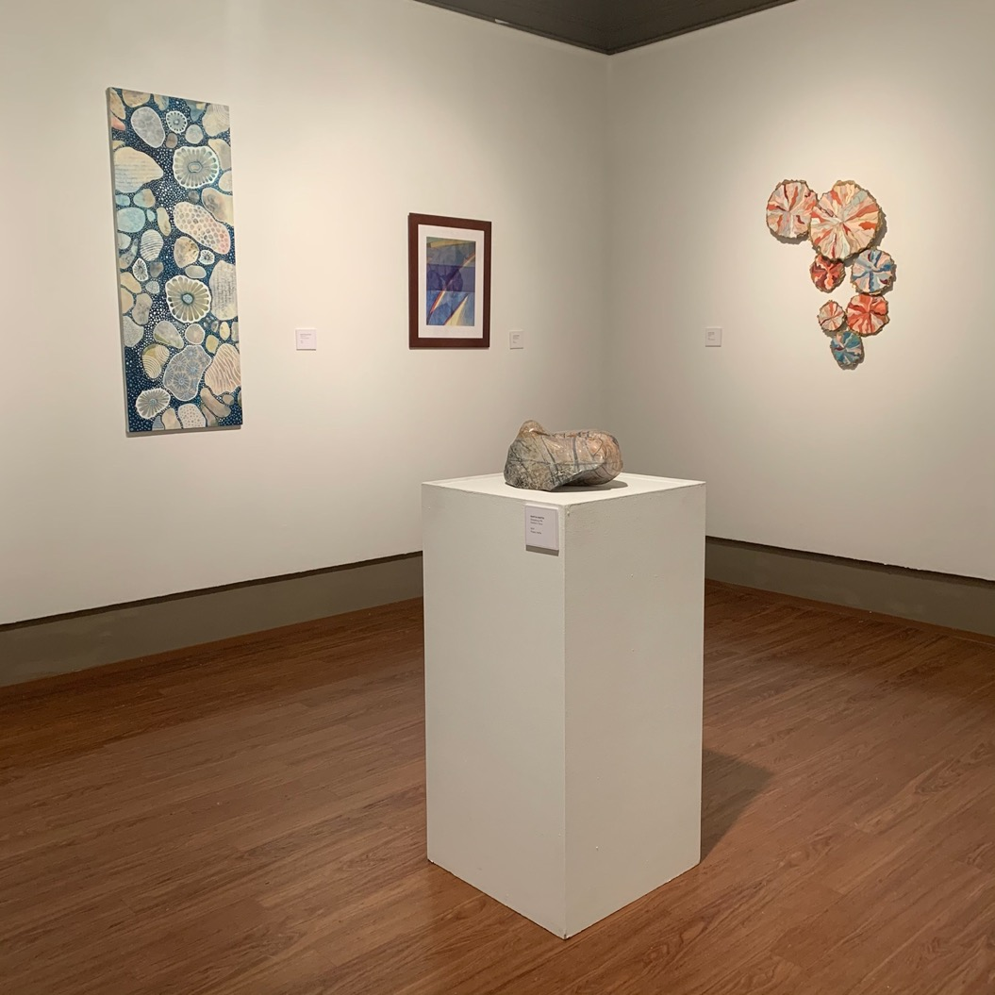

Slide 40
Gerard McFerren, Chambersburg, PA Hen of the Woods via the Trail, 2020, driftwood, stone, lichen, $350

Slide 41
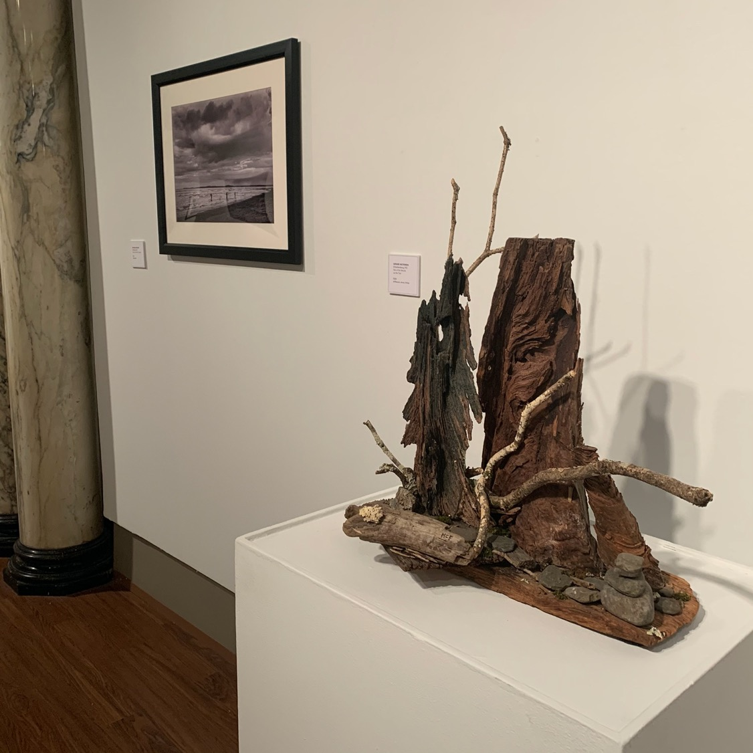

Slide 42
Eric Miller, Hanover, PA Clockwork, 2019, watercolor, $650

Slide 43
Lenore Mills, Dunmore, PA Cherry Blossom Esplanade, 2019, batik, $900

Slide 44
Christian Parker, Arendstville, PA Blue Jay Transom, 2018, stained glass, NFS

Slide 45
Alan Paulson, Gettysburg, PA Horned Ring, 2019, wood, $4000

Slide 46
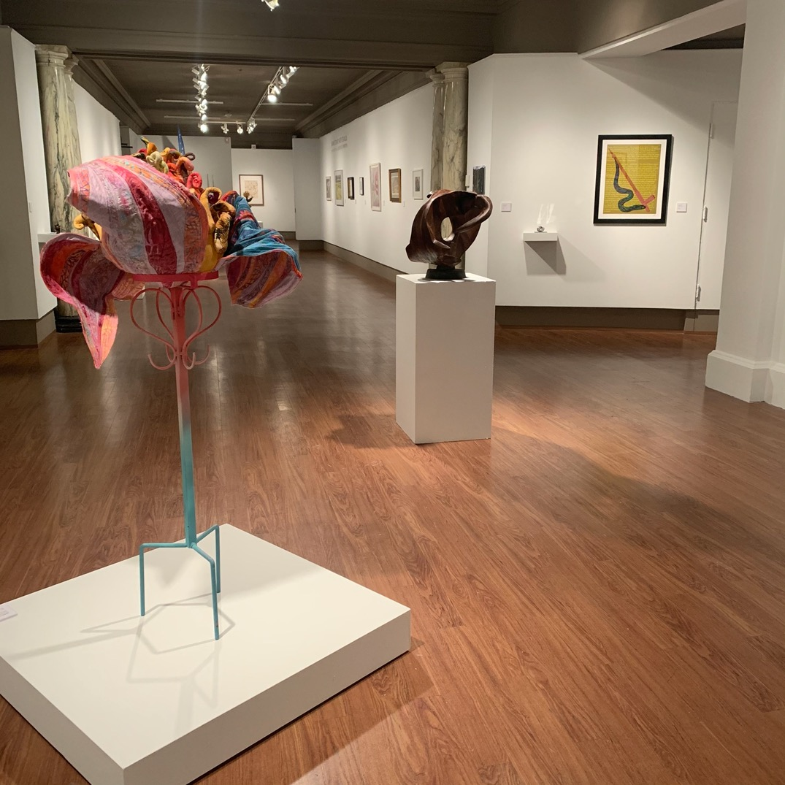

Slide 47
Janet Powers, Gettysburg, PA Forest Waterfall, 2019, digital photograph, $120

Slide 48
Freya Qually, Fairfield, PA Mushroom Portal, 2018, digital photograph, $85

Slide 49
Ted Scarpino, Biglerville, PA Milkweed Explosion, 2019,
archival photograph, $175

Slide 50
Ping Shen, Arnold, MD Lily Magnolia Blossom, 2017,
colors and ink on rice paper, NFS

Slide 51
Peter Smyth, Upper Darby, PA Neon Window Sign, 2019, digital photograph, $340

Slide 52
Gregory Suryn, Gettysburg, PA Iceolation, 2019, photograph, $100

Slide 53
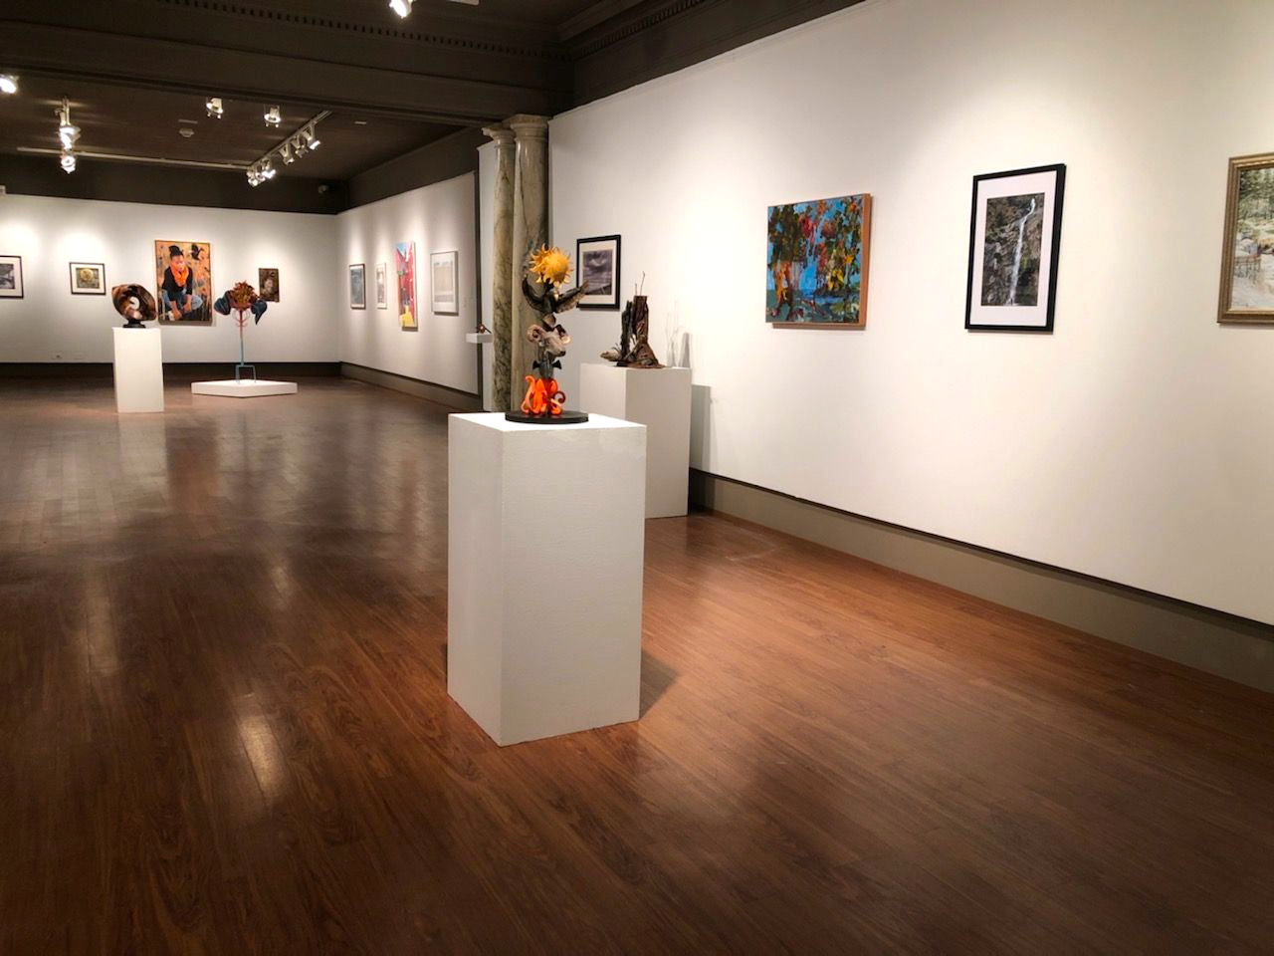

Slide 54
Dora Townsend, Gettysburg, PA High Water, 2019
photograph, $350

Slide 55
Mary Anne Warner, Fayetteville, PA Beginning to Turn, 2018, pastel on paper, $500

Slide 56
Autumn Wright, York, PA Washed Up, 2018, monotype, acrylic, ink, watercolor, $4000

Slide 57
Harold Zabady, Camp Hill, PA Jason and Madison, 2019, oil on canvas, $1500

Slide 58
